Slide 1
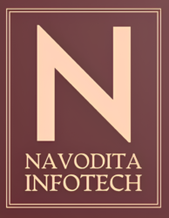
Navodita Infotech Artificial intelligence Internship
Natural Language Processing chatbot
Sanjana S N
Intern Id: 6415

Slide 2

Artificial intelligence
It is a branch of computer science focused on creating machines that can perform tasks typically requiring human intelligence, such as learning, problem-solving, and decision-making.
AI uses technologies to enable systems to understand and respond to language, analyze data, make recommendations, and even mimic human cognitive functions.

Slide 3
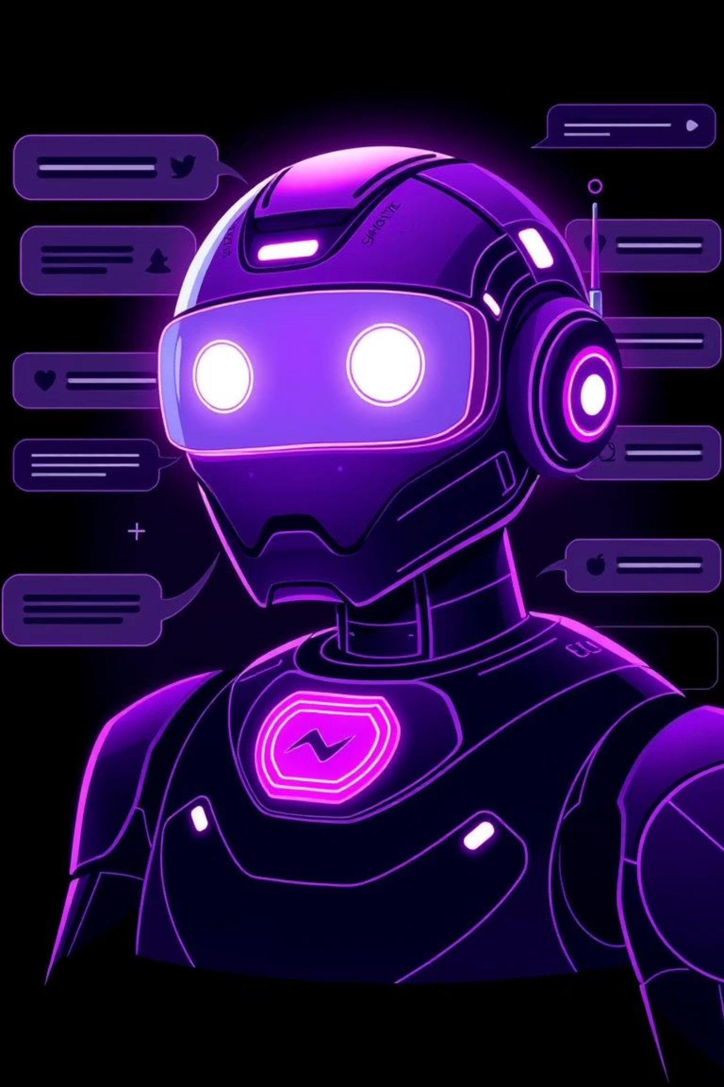
Building a Conversational Chatbot with NLP: Understanding & Responding Naturally

Slide 4
What is an NLP Chatbot?
An NLP chatbot is a sophisticated software application designed to understand and respond to human language in a natural, conversational manner. Unlike older, simpler bots, it leverages artificial intelligence to mimic genuine person-to-person interactions.
Understands and responds to human speech naturally, going beyond mere keyword matching.
Incorporates Natural Language Understanding (NLU) to grasp intent and context.
Employs Natural Language Generation (NLG) to formulate coherent and relevant responses.

Slide 5
Core NLP Techniques Powering Chatbots
Tokenization
Intent Recognition
Breaking down user input into individual words or meaningful units for deeper analysis.
Determines the primary goal or purpose behind the user's message, even with complex phrasing.
Named Entity Recognition (NER)
Dialogue Management
Identifies and categorizes key information like names, dates, locations, or products within a query.
Manages the flow and context of multi-turn conversations, remembering previous interactions.

Slide 6
Types of NLP Chatbots
Retrieval-Based
Generative
Selects the most appropriate response from a predefined set of answers.
Creates novel, unique responses using large language models (LLMs) like GPT.
Hybrid
Contextual
Combines rule-based logic with AI learning for enhanced versatility and accuracy.
Personalizes replies based on ongoing conversation history and specific user data.

Slide 7
How to Build Your Own NLP Chatbot: Key Steps
01
02
Define Purpose & Scenarios
Collect & Preprocess Data
Clearly outline the chatbot's role and the specific user interactions it will handle.
Gather relevant conversational data and prepare it through tokenization and tagging.
03
04
Train Models
Design Dialogue Flows
Develop and train intent classifiers and entity recognizers using machine learning algorithms.
Create logical conversation paths that account for context and user intent.
06
05
Integrate Systems
Continuous Improvement
Connect the chatbot with backend systems for access to necessary data and personalized responses.
Regularly analyze user interactions to refine models and enhance performance.

Slide 8
Challenges & Best Practices
Handle Ambiguity
Ensure Data Privacy
Develop robust models to gracefully manage complex or unclear user queries.
Implement strict protocols for secure handling and protection of user data.
Balance Automation & Human Handoff
Regular Model Updates
Strategically integrate human support for sensitive issues, ensuring a seamless transition.
Continuously refine and update NLP models to adapt to evolving language trends and user needs.

Slide 9
The Future of Conversational Chatbots
Emotion & Nuance Detection:
Chatbots will become even more human-like, understanding subtle emotional cues.
Seamless Multimodal Integration:
Unified experiences across voice, text, and other channels.
Smarter, Faster, Empathetic Service:
Businesses will deliver highly intuitive and compassionate customer interactions.
Start building today – NLP is the key to truly natural and impactful conversations.

Slide 10
Conclusion:
NLP-powered conversational chatbots are not just tools; they are transforming how businesses engage customers by delivering personalized, natural, and highly efficient communication experiences.
Conversational chatbots powered by Natural Language Processing (NLP) are transforming the way humans interact with technology. By enabling machines to understand, interpret, and respond in natural language, these chatbots make digital communication more seamless, personalized, and efficient.
They are no longer just rule-based responders but intelligent virtual assistants that can learn from data, adapt to user needs, and provide meaningful interactions. From customer support and healthcare to education and e-commerce, NLP-driven chatbots are becoming an essential part of modern life.
As AI and NLP continue to evolve, future chatbots will become even more context-aware, empathetic, and human-like, bridging the gap between human conversation and machine intelligence.

